Slide 1


2026
Reveal Every Step of Your Process
AI-Powered Process Intelligence | Continuous Improvement |
Agentic AI Orchestration
Product Guide
www.futuroot.com

Slide 2






Why FUTUROOT?
A Comprehensive and Rapid Time-to-Value Process Intelligence Platforms
FUTUROOT combines enterprise-grade data ingestion, usable process diagnostics, monitoring and AI-enabled action.
BY THE NUMBERS
Embedded Data Universe
50+
50M+
1K+
For Specialists, By Specialists
Native proprietary Connectors for SAP, Oracle, Microsoft, Salesforce CRM and custom ERPS
Enterprises served
Case IDs on platform
Active Practitioners
Backed by 300+ ERP + AI Experts. Built exclusively for Enterprise complexity where generic AI breaks down.
Percipere
Workflow Execution
BACKED BY
300+ employee ERP & AI Gold Partner
Insight led agents that do not just answer questions – they understand and execute end-to-end workflows
SECURITY & COMPLIANCE
SOC 2
ISO 27001
GDPR
Enterprise-
Grade Outputs
Bespoke Partnership
Partners lead with speed, usability and ERP depth: FUTUROOT is a modular platform for discovering, monitoring and acting on process performance
Produces auditable recommendations, governance frameworks, dashboards and smart pdf reporting
Whiteglove deployments led by ex ERP Architects acting as true change management partners

Slide 3


AT A GLANCE...
FUTUROOT LANDSCAPE
Connectors & Transformation
Process Repository
ECC · S/4HANA Public · S/4HANA Private
Oracle · MySQL · Postgres ·
BPMN Creation & Upload · Process Metadata · Process Simulation*
*roadmap
*roadmap
AI Agent
Business & Implementation Users
1. Understand
Business & Implementation Users
Core Platform
Reads live process signals against configured thresholds
AI Copilot
Explore live process maps, review AI-generated insights & recommendations
Discover & Visualize
Analyze & Benchmark
Insights & Capabilities
2. Reason
  Process map visualization
  Variant analysis
  Case drill-down
  Conformance checking
  BPMN modeling
  User management
  Access control
  KPI dashboards
  Benchmarking
  Bottleneck analysis
  AI recommendations
  Root cause AI*
  Global Filters
  Reports and smart PDF
  Action engine
  KPI threshold triggers
  External AI agents
  MCP server*
  AI Model Integration
  Generate dashboards
  Generate KPI widgets
  AI co-pilot
Traces the chain to pinpoint the root cause & scores by business impact
3. Act
Natural language access to your entire process intelligence layer
Takes targeted, context-rich action across systems with full process context
4. Adapt & Monitor
*roadmap
*roadmap
Closes loop, tracks recurring pattern, surfaces process redesign candidates
AUTOMATING BUSINESS PROCESSES
Query & Reasoning
Data Integration
Notifications
Ticketing & Workflow
SQL · AI Reasoning · Prompt
SAP OData · HTTP REST
Email · MS Teams
ServiceNow · JIRA
Human Oversight
Trusted Intelligence Layer
Autonomous Execution
Users configure, review and control agent actions
Governed, accurate, real-time process intelligence
Threshold breach → ServiceNow ticket + Teams notification

Slide 4












DEVELOPED AND ROAD TESTED IN
REAL-WORLD TRANSFORMATIONS
Enterprise
Systems
Cloud
Platforms
Legacy
Systems
Connectors & Integration
Capabilities
Integrations with Cloud Platforms through REST APls (Salesforce, SAP Public Cloud
Seamless connectivity to
SAP Systems via JAR using standard RFCs and Oracle EBS via On-Prem connectors
Custom Connectors
for Legacy Systems
available based on engagement scope.
..........
..........
..........
Core ETL functions
AVAILABLE CONNECTORS
Extraction tasks
Ingests relevant source tables from ERP via secured built-in connectors or upload data using SFTP or file-based methods.
SAP ECC
SAP Private Cloud
SAP Public Cloud (REST API)
SAP HANA
DB Connector
Salesforce
Connector via
REST API
Oracle E-Business Suite on-prem
JDBC
Connector
FTP
Connector
Data Anonymization
Masks or anonymizes sensitive business and personal data to support privacy, compliance, and secure analytics.
Data Anonymization
Transforms raw ERP source tables into standardized event logs using configurable data models and SQL-based transformation logic.
..........
..........
Data Modeling & Transformation
..........
File upload
Allows xlsx, csv and txt files to be uploaded directly where live extraction is not required or not yet available.
Delta extraction
Captures only changed or updated data from SAP source systems to keep event logs current and reduce redundant processing.
Notes:
5 Point Package Framework:
Package Architecture & Methodology
Data Models, Log Frameworks & Connectors
Analytics Templates & AI Models
Outputs & Deliverables
Partner & Customer Rights
FUTUROOT Pulse – Process/LoB/Business/Landscape Health Check Package
FUTUROOT Control Tower – Operational Insights, Monitoring & Continuous Improvement
FUTUROOT Compliance & Audit Shield – Management/Internal Audit Accelerator
FUTUROOT Productivity Boost – Deep dive in Industry or Function problem
FUTUROOT S/4 Data Intelligence & AI Readiness – Migration of SAP ECC to SAP S/4HANA
FUTUROOT Agentic AI Accelerator – AI Discovery, Orchestration, Governance and Remediation
FUTUROOT SAP S/4HANA Transformation – Business Case and Transformation Platform
PACKAGE 2 — FUTUROOT Control Tower (RPC, OS Doors, Vets4Pets, BookmyShow)
Operational Insights & Monitoring Package: Provide operations continuous visibility.
Target: Supply chain heads, COOs, operational controllers, Finance controllers
Includes:
2–3 processes monitored continuously
Custom dashboards (cycle time, SLA breaches, exceptions)
Real-time alerts (threshold-based + anomaly detection) based on predefined rules
Periodic operational reports for functional teams
Root-cause analytics for deviations, augmenting continuous improvement.
Outcome: Command centre for operations, powered by FUTUROOT.
PACKAGE 3 — FUTUROOT Compliance & Audit Shield (Baramati)
Package Variant: LifeScience/Pharma GxP edition
GxP / SOX / Internal Audit Insights Package (6–10 weeks): Address highly regulated customers (pharma, utilities, food).
Includes:
Control violations detection (e.g., GR without PO, backdated postings)
Segregation of duties analysis
Audit log mapping (who did what, when)
Standard risk library integration
Traceability & compliance scorecards
Outcome: A compliance-ready AI-driven audit layer.

Slide 5
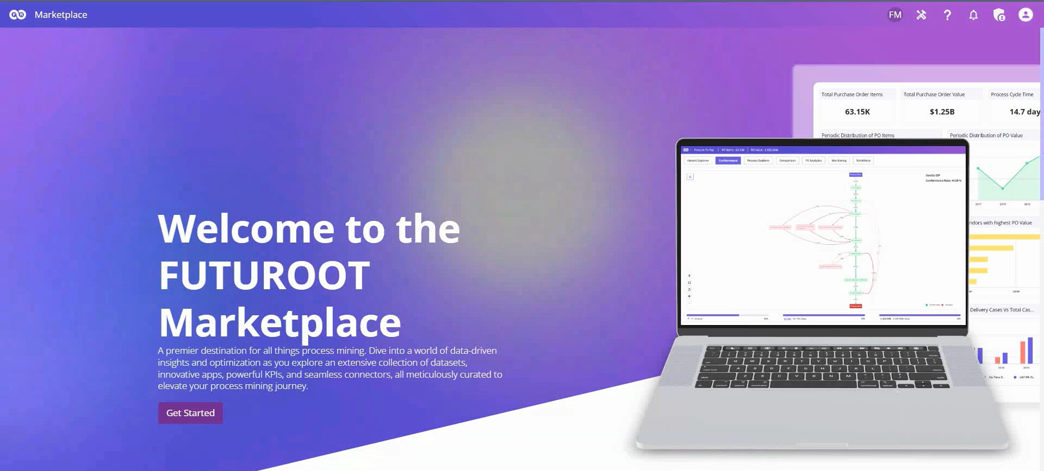
Marketplace
Accelerate deployment with ready-made business solutions.
Overview
Deploy pre-built process intelligence solutions designed for common business scenarios, enabling organisations to deliver value faster with minimal implementation effort.
Business Value
Reduce implementation time
Leverage industry-ready solutions
Accelerate time-to-value
Watch the walkthrough
Solution Packages
One-click Deploy
Updates
Industry-Wide packages

Slide 6
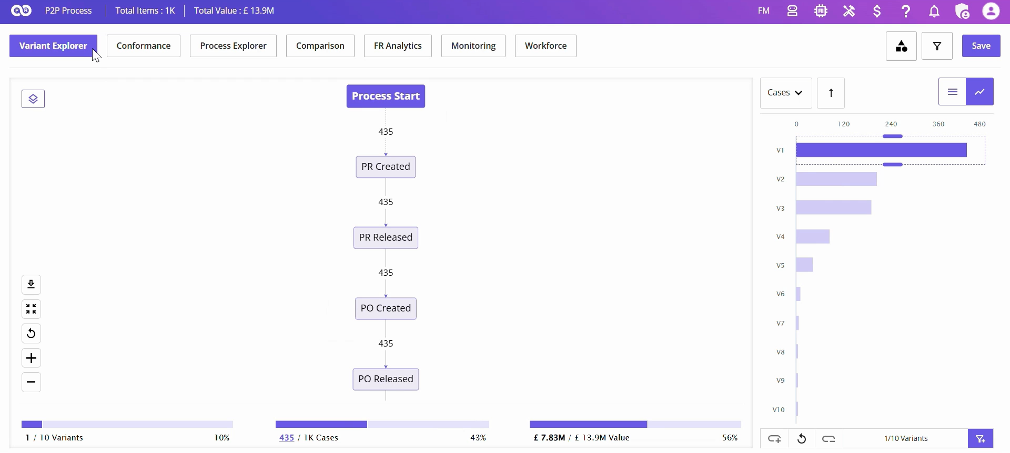
Process Discovery
Turn ERP data into complete process visibility.
Overview
Discover how your business processes actually execute using real ERP event data. Visualize process flows, uncover inefficiencies and identify opportunities for continuous improvement.
Business Value
Understand actual process execution
Identify bottlenecks and process variations
Prioritise improvement opportunities
Watch the walkthrough
Variant Explorer
Bottlenecks
Filters
Process Metrics

Slide 7
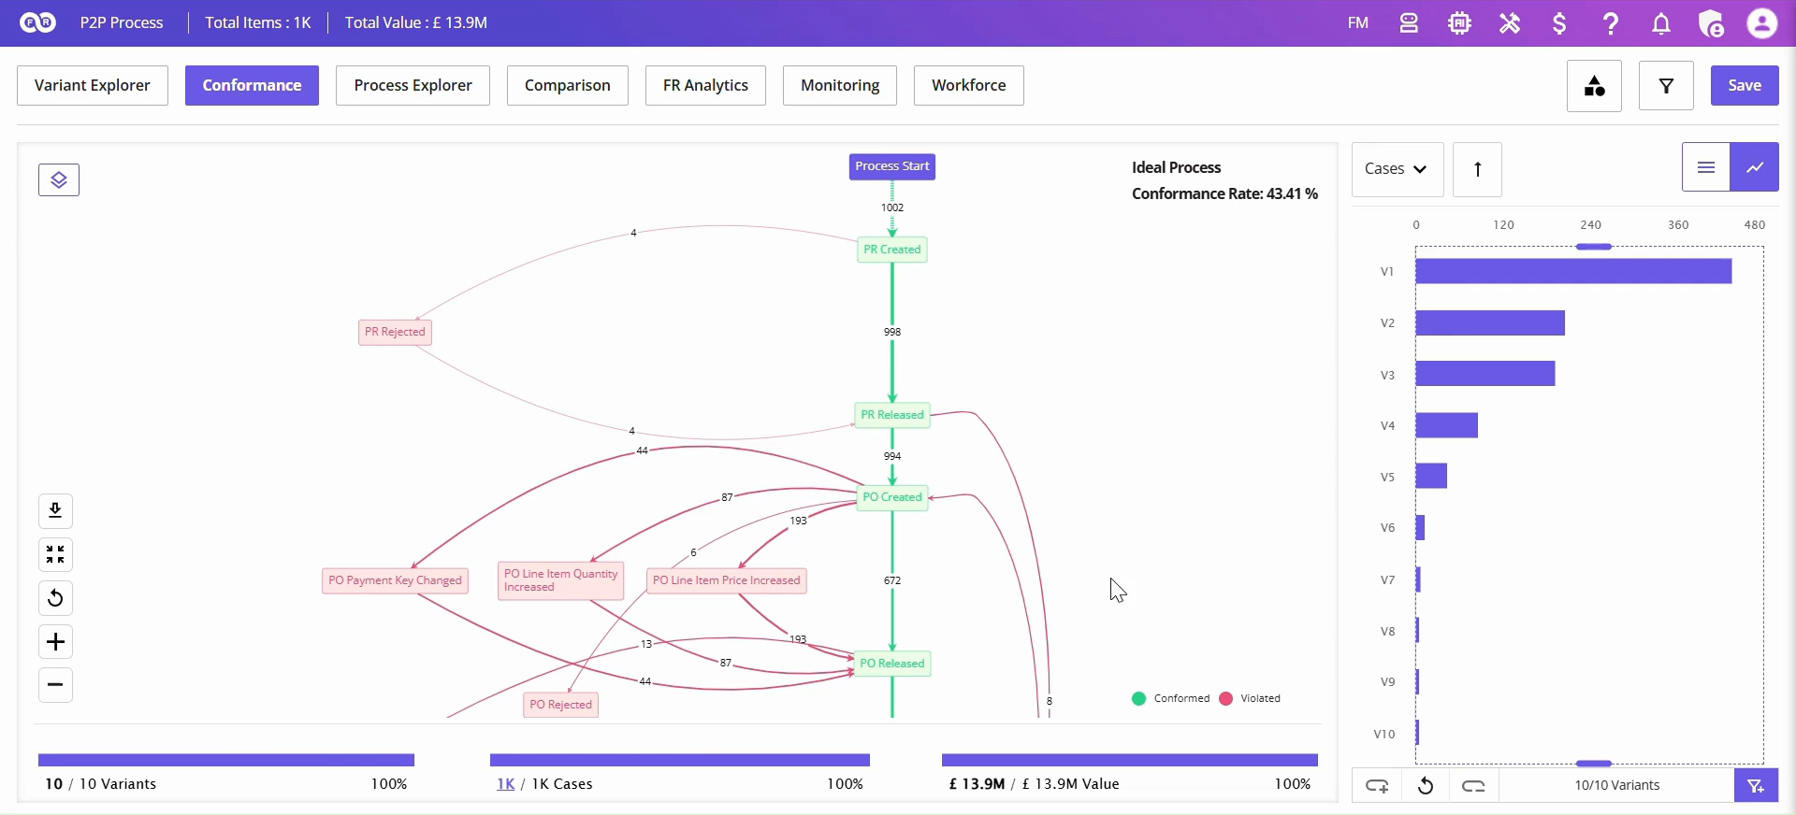
Process Conformance
Ensure every process follows the intended path.
Overview
Compare actual process execution against your designed business processes to identify deviations, improve compliance and strengthen operational governance.
Business Value
Improve process compliance
Detect deviations early
Standardise business execution
Watch the walkthrough
Ideal Process
Root Cause Analysis
Violation Metrics
Dimension Comparison

Slide 8
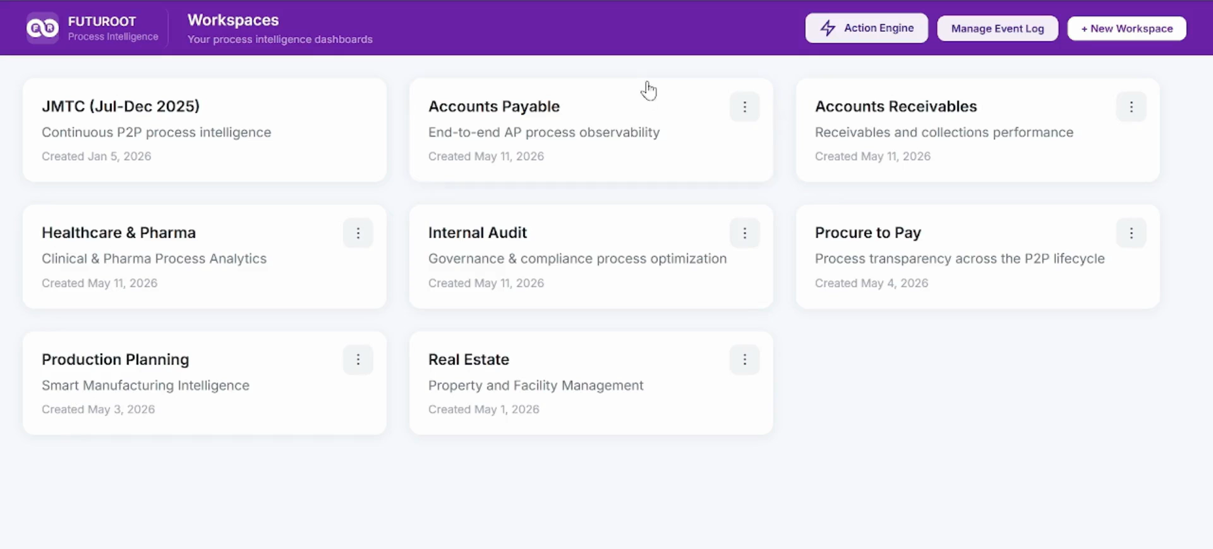
Control Tower
Monitor operations with real-time business insights.
Overview
Track KPIs, dashboards and operational alerts from a single business cockpit, enabling proactive monitoring across enterprise processes.
Business Value
Monitor KPIs in real time
Respond proactively to issues
AI Assisted Dashboard and KPI creation
Improve operational performance
Watch the walkthrough
KPIs
Dashboards
Alerts
Workflow Triggers

Slide 9
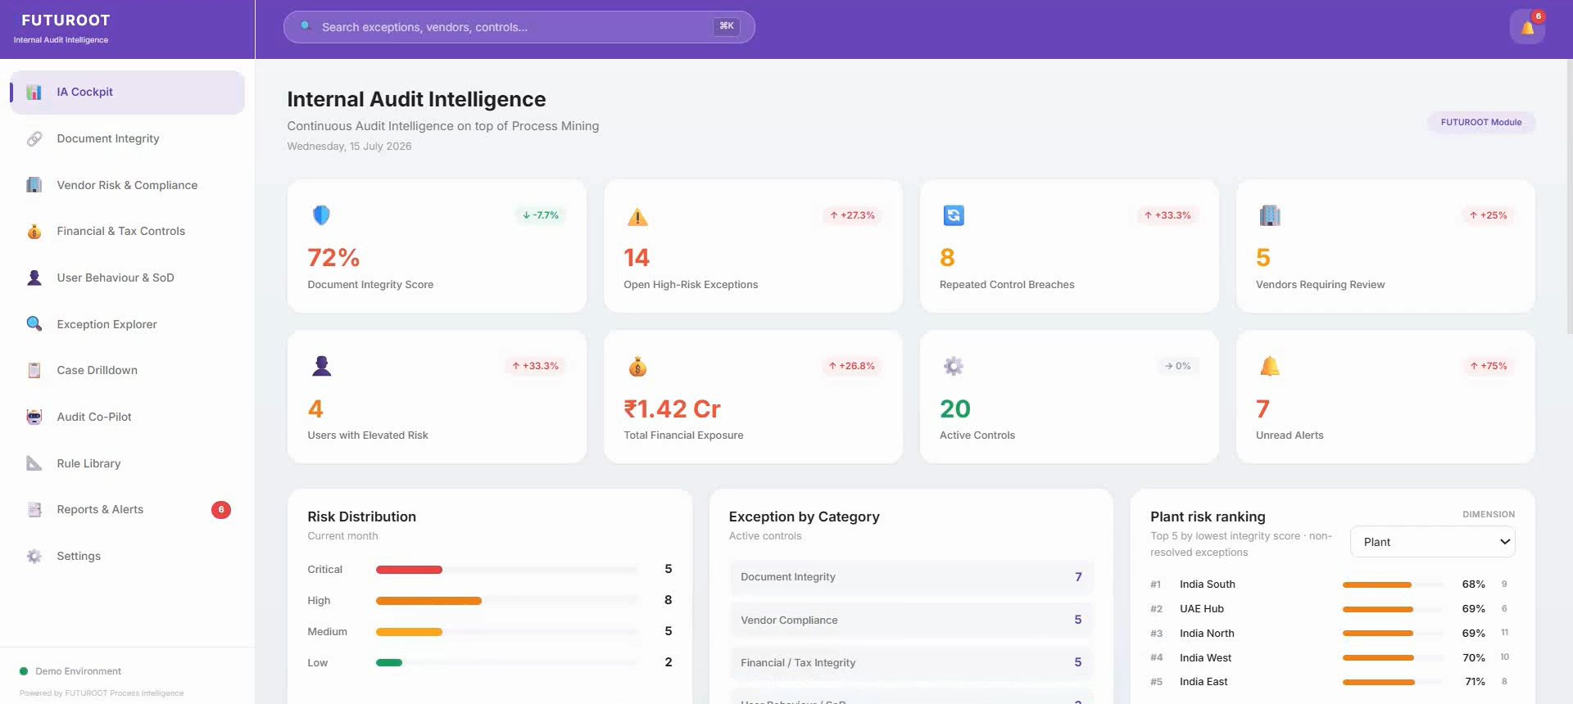
Continuous Controls Monitoring
Move from periodic audits to continuous assurance with 100% coverage.
Overview
Continuously evaluate business controls and compliance using automated monitoring that detects exceptions and operational risks as they occur.
Business Value
Reduce manual audit effort
100% Data coverage
Detect risks earlier
Strengthen governance
Watch the walkthrough
Audit Controls
Review Exceptions
Continuous Assurance
AI Copilot Assistance

Slide 10
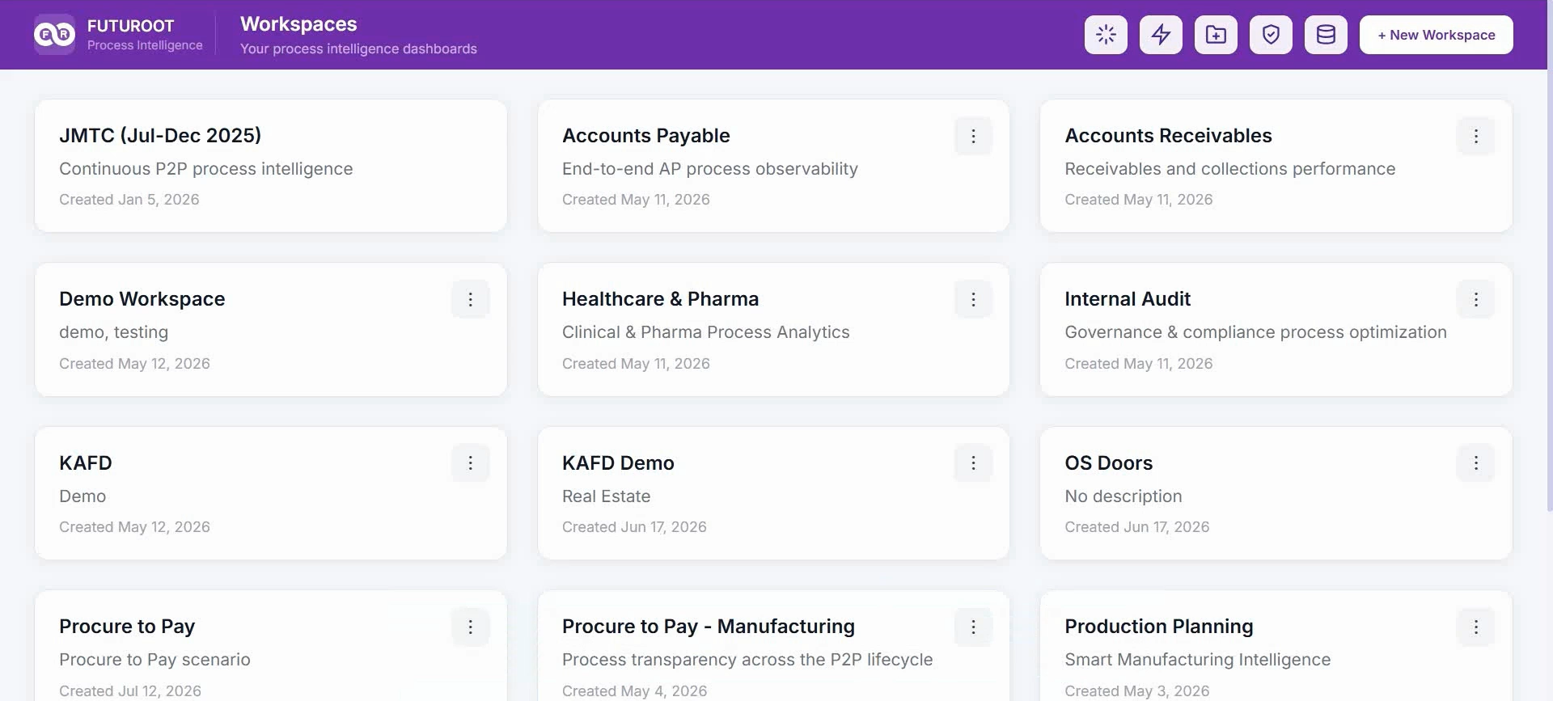
Agent Studio
Turn insights into automated business actions.
Overview
Automate business workflows by triggering notifications, approvals and enterprise actions based on real-time process events and business conditions.
Business Value
Eliminate manual follow-ups
Accelerate issue resolution
Automate business processes
Watch the walkthrough
Action Workflow Builder
Triggers
Notifications
Enterprise Integrations

Slide 11
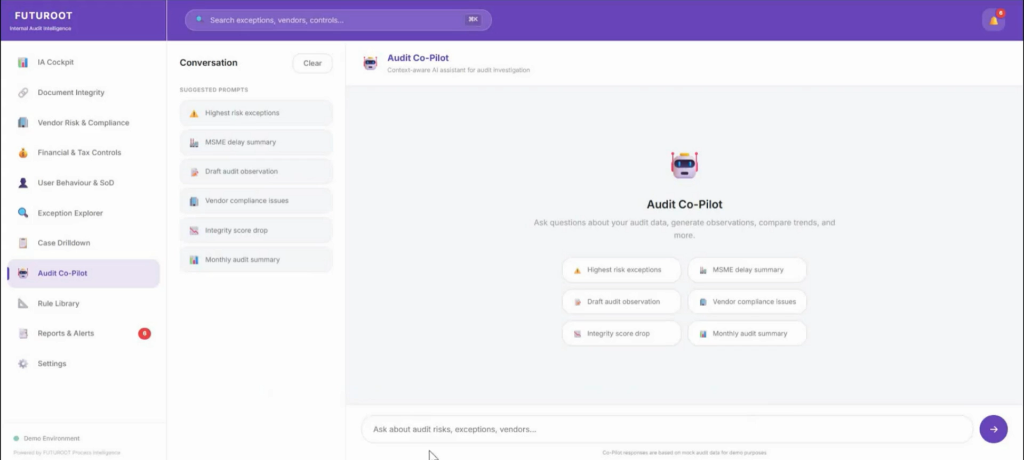
AI Copilot & Agentic AI
Enterprise AI built into every workflow.
Overview
Empower business users with AI-assisted analysis, intelligent recommendations and natural language interactions to accelerate decision-making and automation.
Business Value
Analyse faster with AI
Simplify complex investigations
Enable smarter decisions
Watch the walkthrough
AI Copilot
Natural Language
Agentic AI
MCP Integration

